Slide 1
GRAPHICAL INPUT OUTPUT DEVICES
Notes:
‹#›

Slide 2
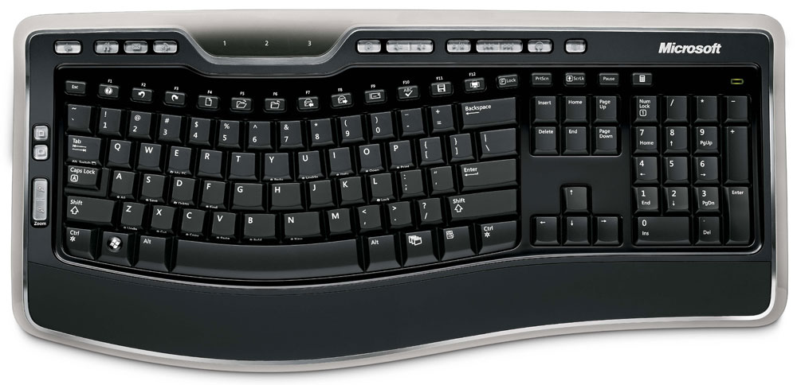
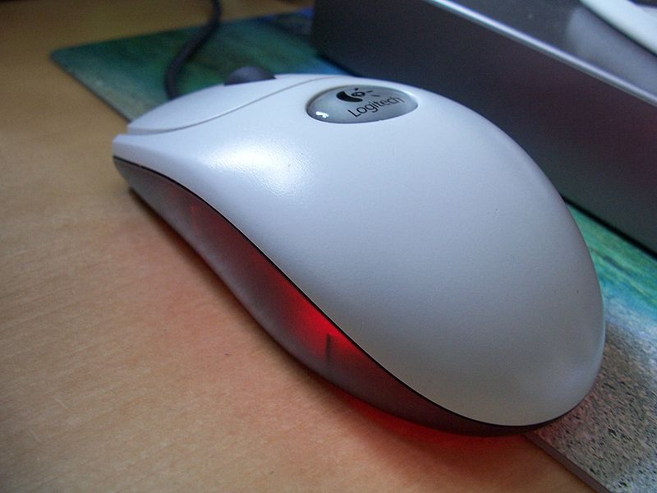
WHAT IS AN INPUT DEVICE?
An input device is any peripheral used to provide data and control signals to an information processing system.
Notes:
‹#›

Slide 3
LIST OF SOME INPUT DEVICES:
Mouse
Keyboard
Trackball
Space ball
Joystick
Digitizer
Dials
Button boxes
Notes:
‹#›

Slide 4
APPLICATION BASED INPUT DEVICES:
Data gloves
Touch panels
Image scanners
Voice systems
Notes:
‹#›

Slide 5
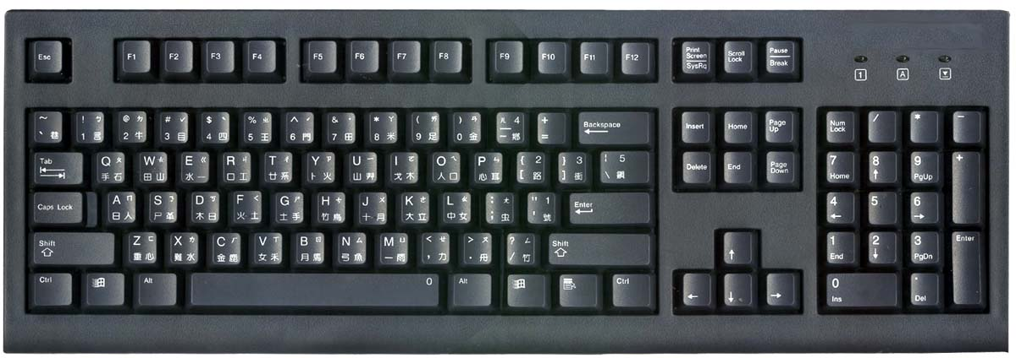
KEYBOARD
Notes:
‹#›

Slide 6
KEYBOARD
IT is a device primarily used to enter TEXT
STRINGS.
APLLICATIONS:
Used to enter Text Strings
Short cuts to many Functions
In Graphics:
Used to provide screen coordinates
Menu selection
Gaming controls
And FOR entering many graphics function
Notes:
‹#›

Slide 7
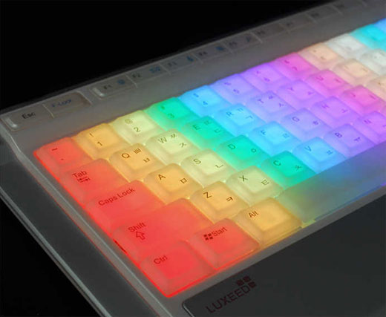
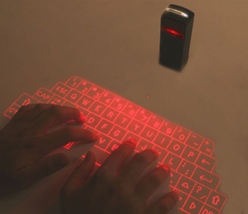
LATEST TYPES:
Notes:
‹#›

Slide 8
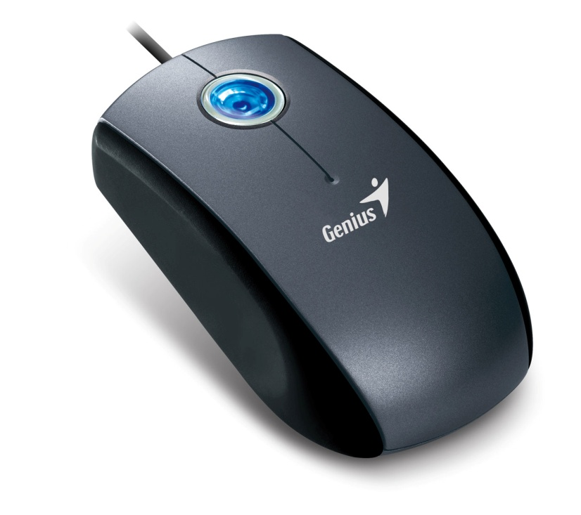
MOUSE
Notes:
‹#›

Slide 9
MOUSE
Hand-held BOX used to position the screen
cursor
Wheels or Rollers(now-a-days Laser lights)
on the bottom are used to record the position
of the screen
Generally there are two or three buttons,
used for operations like recording of the
cursor positions or invoking of a function
In order to increase the number of INPUT
parameters, additional devices can be
included
The Z-MOUSE is an example of this
Notes:
‹#›

Slide 10
Z-MOUSE
KEY FEATURES:
Has three buttons, a thumbwheel on the
side, a trackball on the top and a standard
mouse ball underneath
This provides SIX degrees of freedom to
select the positions, rotations ETC
Allows 3D viewing
Applications:
Animation
Auto CAD
And many more areas
Notes:
‹#›

Slide 11

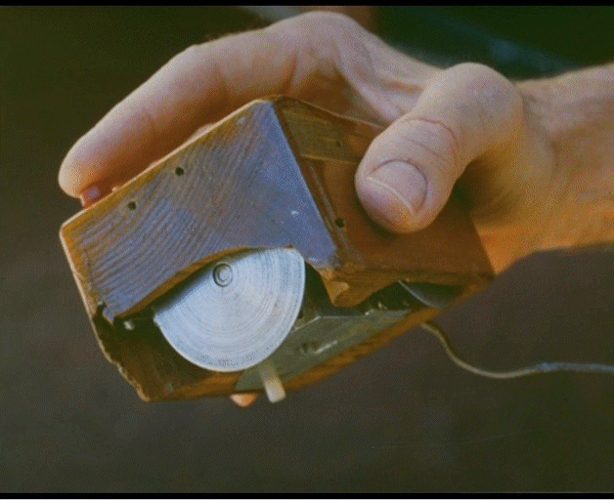
SOME FACTS ABOUT THE MOUSE(COMPUTING)
Invented By Douglas C Engelbart
An AMERICAN inventor
The first prototype computer mouse was made
to use with a graphical user interface, in 1964
It was patented on 17 November 1970,
under the name "X-Y Position Indicator For A
Display System“
Notes:
‹#›

Slide 12
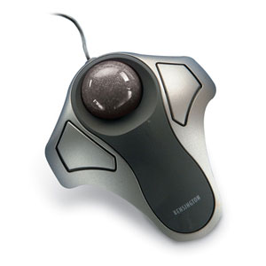
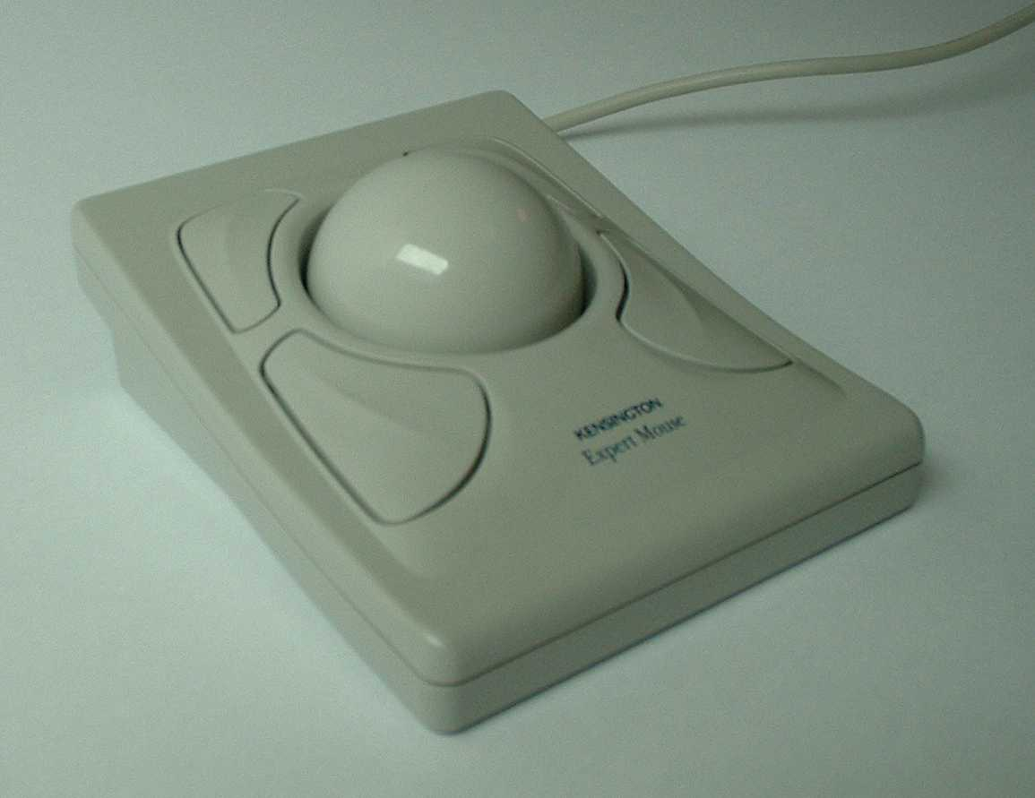
TRACKBALL AND SPACEBALL
Notes:
‹#›

Slide 13
TRACKBALL
It is a 2D positioning device
It consists a ball held by a socket
containing sensors to detect the rotation of
ball about TWO axis
User rolls the ball to move the cursor
They are often mounted on devices such as
keyboards, Z-mouse ETC
Notes:
‹#›

Slide 14
SPACEBALLS
It provides SIX degrees of freedom
It is a fix device
Movement detection is done using strain
gauges
Cursor can move in any direction
It is more efficient then trackball
Notes:
‹#›

Slide 15
APPLICATIONS:
Used in CAD workstations
In animation
Sometimes on special Workstations such as
the radar consoles in air-traffic control
room
In Gaming consoles
People with a mobility impairment use
trackballs as an assistive technology input
device
Notes:
‹#›

Slide 16
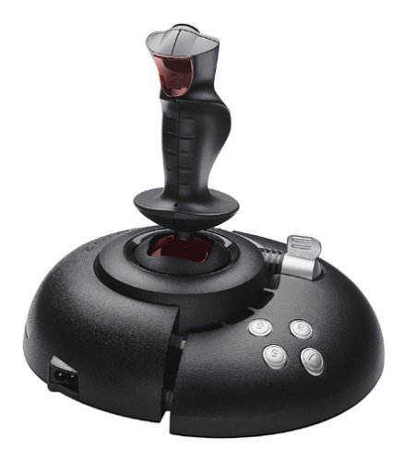
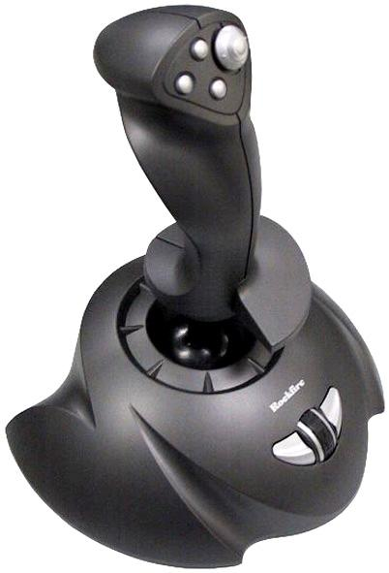
JOYSTICK
Notes:
‹#›

Slide 17
JOYSTICK
Consists of a stick pivoted on a base
Used to steer the screen cursor
It also has one or two PUSH buttons as
input switches to perform certain actions
Most joystick are 2D, but 3D do exist
Distance moved from the CENTER position
corresponds to the screen cursor
movement in that direction
Notes:
‹#›

Slide 18
APPLICATIONS:
In Gaming consoles
In 3D animation
Used to drive machines like cranes, mining
trucks, hydraulics ETC
Used as assistive technology pointing
device such as in Electronic wheelchairs
Notes:
‹#›

Slide 19
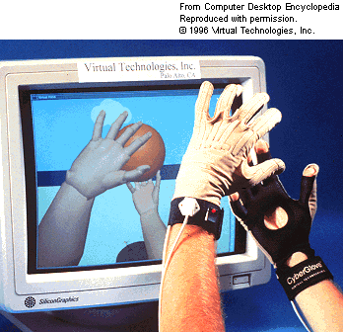
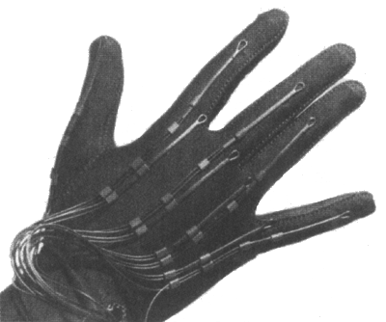
DATA GLOVE
Notes:
‹#›

Slide 20
DATA GLOVE
Used to grasp a “virtual” object
Uses sensors to detect the Hand and
finger motion
Electromagnetic coupling between
signals provides information about the
position and orientation of the HAND
Notes:
‹#›

Slide 21
APPLICATIONS:
In 3D animation movies
Visual effects
Gestures can be categorized into
useful information, such as to
recognize Sign Language or other
symbolic functions
3D Virtual environment Games

Slide 22
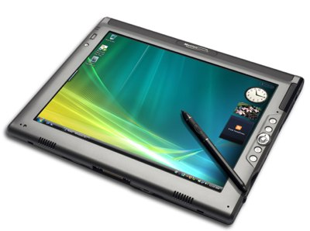
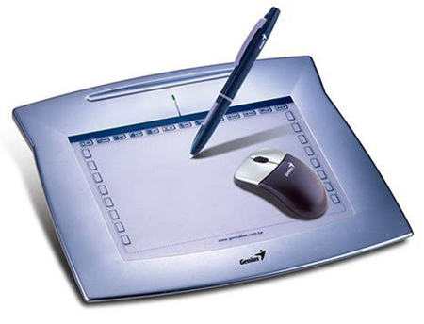
DIGITIZERS
Notes:
‹#›

Slide 23
DIGITIZERS
Common device for drawing, painting,
or interactively selecting coordinate
positions on an object
Typically, it is used to scan an Object and
to input discrete coordinate positions
ONE TYPE of Digitizer is the Graphics Tablet
Notes:
‹#›

Slide 24
GRAPHICS TABLET
A graphics tablet is a computer input
device that allows one to hand-draw images and
graphics, similar to the way one draws images
with a pencil and paper. These tablets may also
be used to capture data or handwritten
signatures
The common drawing TOOLS used to draw are
HAND CURSOR and STYLUS
A STYLUS is a pencil-shaped pointing device

Slide 25
GRAPHICS TABLET
This Digitizing system uses electromagnetic
resonance to detect the 3D positions of the
STYLUS
This allows one to produce different shades of
brush strokes with different pressure on its
surface
Acoustic Tablets use sound waves to detect the
position of the STYLUS
Notes:
‹#›

Slide 26
GRAPHICS TABLET
3D Digitizers use sonic or electromagnetic
transmissions to record positions
It uses the same mechanism used in the
Data Gloves
Notes:
‹#›

Slide 27
APPLICATIONS:
Used in generating Computer generated
graphic images
Used in creating characters for Animation
In Technical drawings and CAD
Used for Handwriting recognition
Notes:
‹#›

Slide 28
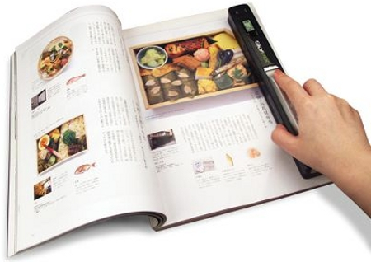
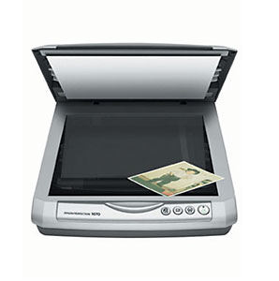
IMAGE SCANNERS
Notes:
‹#›

Slide 29
IMAGE SCANNERS
In computing, a scanner is a device that
optically scans images, printed text, handwriting,
or an object, and converts it to a digital image
When the scanning is performed, the gradation
of gray scale or colors are recorded and stored in
an array
Once scanned, any kind of transformations can
be applied to the object image
Notes:
‹#›

Slide 30
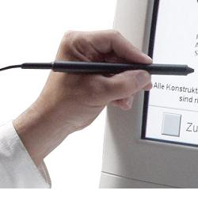
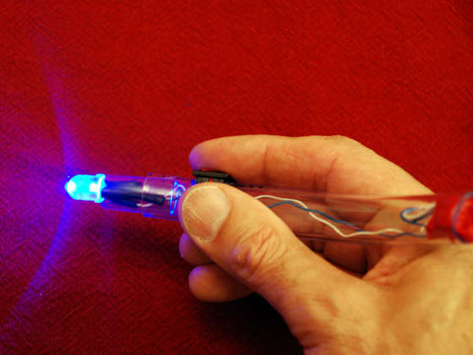
LIGHT PENS
Notes:
‹#›

Slide 31
LIGHT PENS
A light pen is a computer input device in the
form of a light-sensitive wand used in
conjunction with a computer's CRT TV set
or monitor
Allows the users to point to displayed objects
and to draw objects on screen
The position points are highly accurate and
sensitive
It generates electrical pulse which records the
position of the electron beam
Not very much popular
Notes:
‹#›

Slide 32
LIGHT PENS
Disadvantages:
When pointed on the screen, part of the
image becomes DARK by hand and the pen
As they cannot detect black areas, special
implementation are needed
Sometimes give false readings due to the
background lighting in a room
Notes:
‹#›

